Slide 1
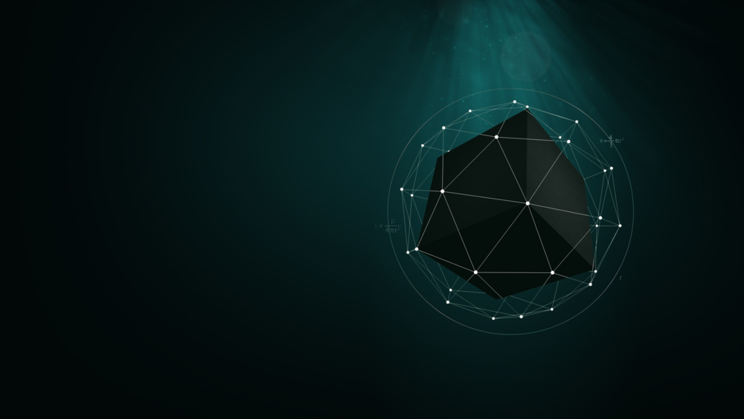
Deep Learning
By Samuel Ojumah (10CG011029)

Slide 2
Outline
Introduction
Aim and Objectives
Review of the Concepts
Related works
Specific Application Areas
Conclusion
References
Acknowledgement

Slide 3
Introduction
Deep learning is a new area of machine learning research introduced with the objective of moving machine learning closer to one of its original goals: Artificial Intelligence.

Slide 4
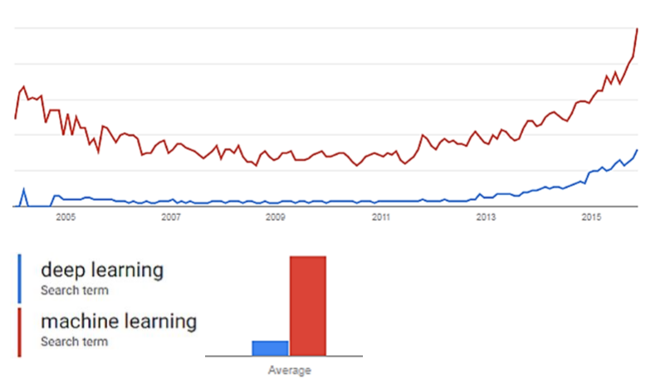
Source: Google
Google Trends
Fig 1: Trends for Machine learning and deep learning

Slide 5
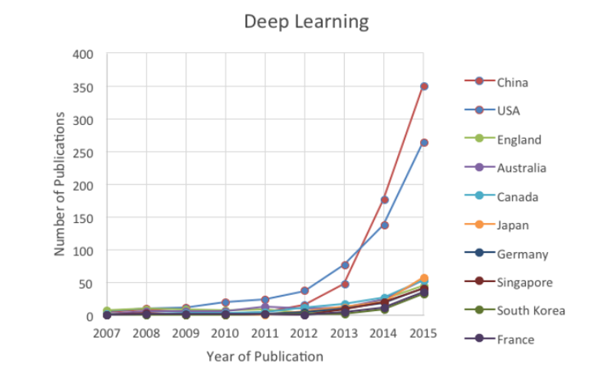
Fig 2: Trends for Machine learning and deep learning
Source: Bloomberg

Slide 6
Aim
To introduce the concept of deep learning and its applications.

Slide 7
Objectives
Situating deep learning within the machine learning domain.
Discuss the various application domains of deep learning.

Slide 8
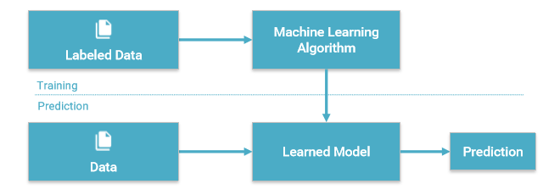
Machine Learning
Machine Learning is a type of Artificial Intelligence that provides computers with the ability to learn without being explicitly programmed (Alpaydin, 2014; Natarajan, 2014).
Figure 3: Diagrammatic representation of the machine learning concept
Source: http://www.slideshare.net/LuMa921/deep-learning-the-past-present-and-future-of-artificial-intelligence

Slide 9
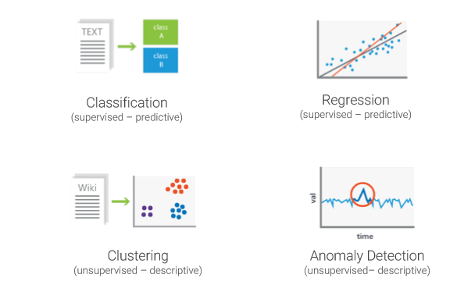
Deep Learning as a subset of machine learning
Machine Learning has a number of algorithms that can be used to learn from data and solve different types of problems as shown in Figure 2.
Artificial Neural Networks (ANN) is one of such algorithms.
A deep neural network is a type of ANN with several hidden layers.
Figure 4: Problem Types in Machine Learning
Source: http://www.slideshare.net/LuMa921/deep-learning-the-past-present-and-future-of-artificial-intelligence

Slide 10
Advent of Deep Learning
1958: Perceptron
1969: Perceptron Criticized
1974: Backpropagation
1995: Reign of SVM.
1998: Convolutional Neural networks for Handwritten recognition.
2006: Restricted Boltzmann Machine
2012: Google Brain Project on 16,000 cores.

Slide 11
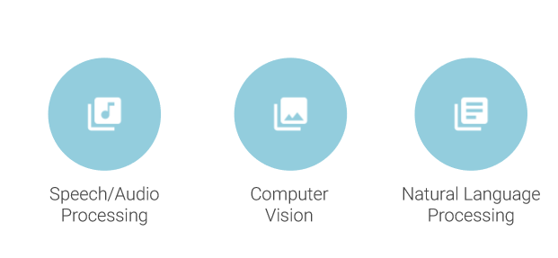
Deep Learning Application Domains
Figure 5: Deep Learning application areas
Source: http://www.slideshare.net/LuMa921/deep-learning-the-past-present-and-future-of-artificial-intelligence

Slide 12
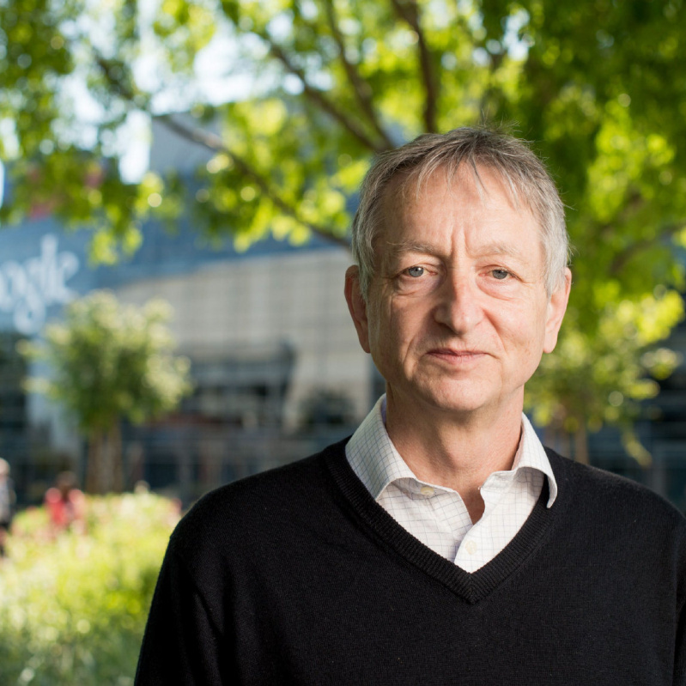
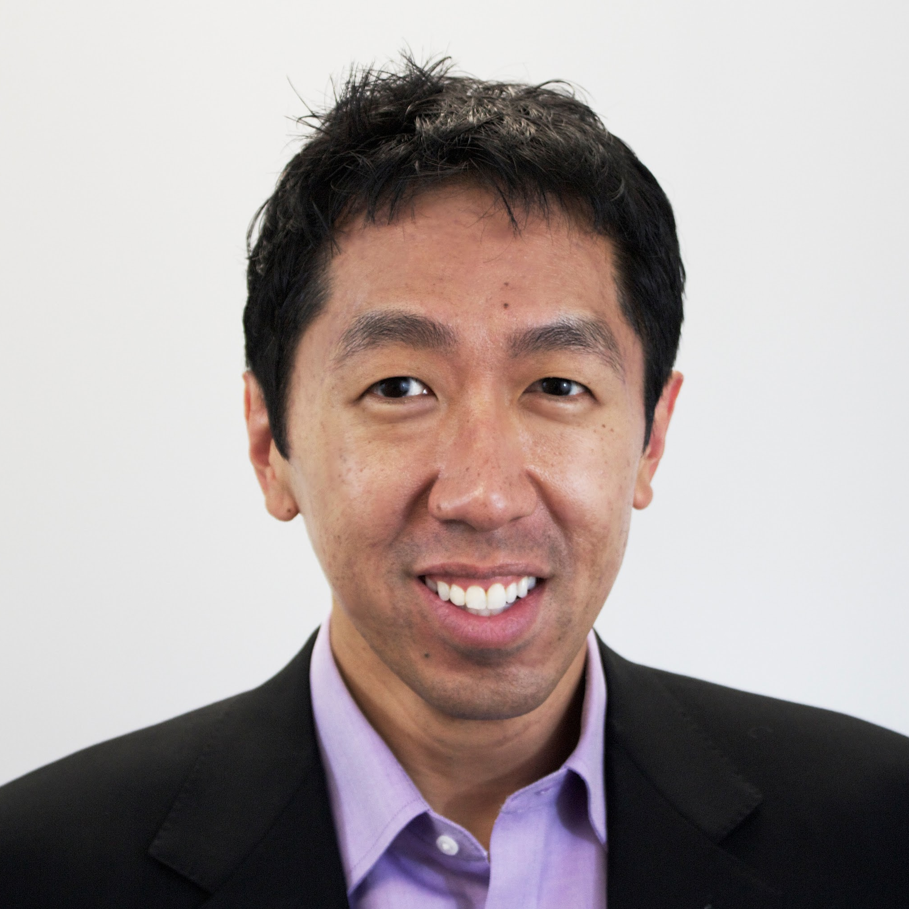
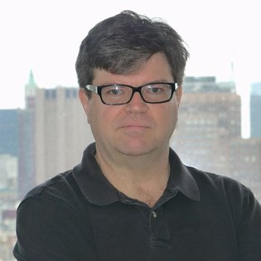
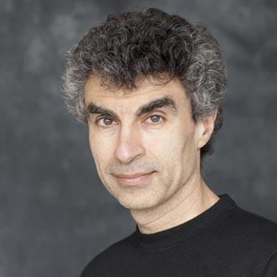
Notable Researchers
Geoffrey Hinton
Andrew Ng
Yann Lecun
Yoshua Bengio
University of Toronto, Google.
Stanford, Baidu
New York University, Facebook
University of Montreal

Slide 13
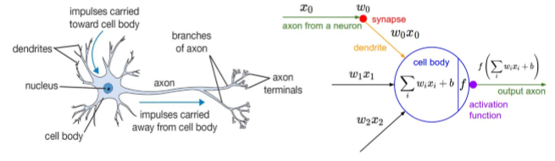
The Neuron
An artificial neuron contains a nonlinear activation function and has several incoming and outgoing weighted connections. Neurons are trained to filter and detect specific features or patterns (e.g. edge, nose) by receiving weighted input, transforming it with the activation function and passing it to the outgoing connections
Figure 6: Structure of the Neuron
Source: http://www.slideshare.net/LuMa921/deep-learning-the-past-present-and-future-of-artificial-intelligence

Slide 14
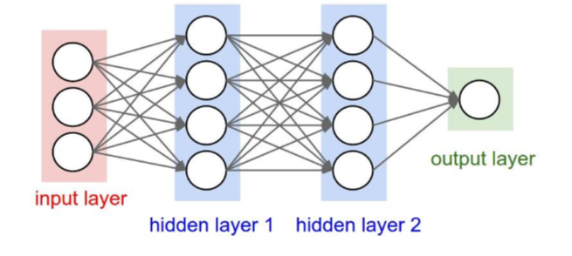
Neural networks
Consists of one input, one output and multiple fully-connected hidden layers in between. Each layer is represented as a series of neurons and progressively extracts higher and higher-level features of the input until the final layer essentially makes a decision about what the input shows.
Figure 7: A neural network showing its layers
Source: http://cs231n.github.io/convolutional-networks

Slide 15

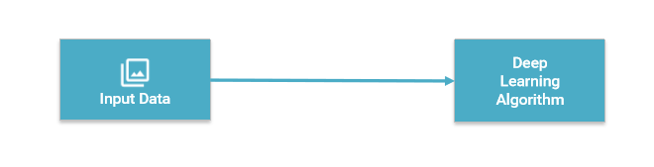
Deep Learning - Basics
No more feature engineering.
Figure 8: Traditional machine-learning architecture and deep learning architecture
Source: http://www.slideshare.net/LuMa921/deep-learning-the-past-present-and-future-of-artificial-intelligence

Slide 16
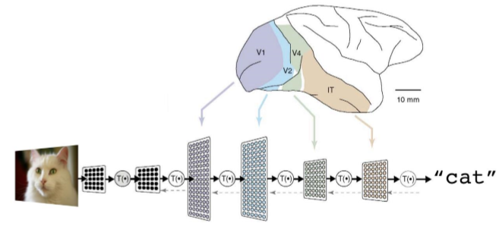
Deep Learning - Architecture
A deep neural network consists of a hierarchy of layers, whereby each layer transforms the input data into more abstract representations (e.g. edge -> nose -> face). The output layer combines those features to make predictions
Figure 9: A deep neural network architecture for recognizing a cat photo
Source: https://cloud.google.com/blog/big-data/2016/07/understanding-neural-networks-with-tensorflow-playground

Slide 17
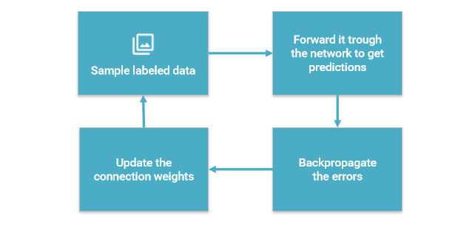
Training
Learns by generating an error signal that measures the difference between the predictions of the network and the desired values and then using this error signal to change the weights (or parameters) so that predictions get more accurate.
Figure 10: Training in a Deep neural network
Source: http://www.slideshare.net/LuMa921/deep-learning-the-past-present-and-future-of-artificial-intelligence

Slide 18
So why did Deep neural networks take that long to be popular?

Slide 19
Vanishing Gradient Problem
(Bengio et al., 2009) outlined the vanishing gradient problem associated with Deep architectures.
Training a neural net involves Backpropagation :
Constantly calculating the Cost value: Predicted output - Actual Output.
Cost lowered by making adjustments to the weights and biases.
Using backpropagation to train deep nets leads to Vanishing Gradient as training takes too long and accuracy really suffers.

Slide 20
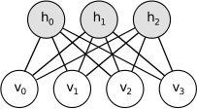
Restricted Boltzmann Machine (RBM)
(Hinton et al., 2006) introduced the concept of an RBM which can find patterns in our data by reconstructing the input.
RBM is a shallow two-layer net, the hidden and visible layers with each node in the visible layer connected to each in the hidden layer.
Figure 11: A Restricted Boltzmann Machine
Source: http://deeplearning.net/tutorial/rbm.html

Slide 21
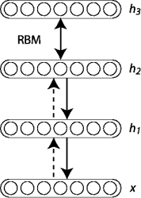
Deep Belief Network (DBN)
(Hinton et al., 2006) showed that RBMs can be stacked and trained in a greedy manner to form so-called Deep Belief Networks (DBN).
DBNs are graphical models which learn to extract a deep hierarchical representation of the training data
Figure 12: RBM layers in a DBN
Source: http://deeplearning.net/tutorial/DBN.html

Slide 22
Other Architectures
Deep Neural Networks
Convolutional Neural networks
Recurrent Neural networks

Slide 23
When Should I use a Deep neural network?
Simple Patterns – Support Vector Machines, Logistic regression.
Moderate Patterns - Neural networks
Complex Patterns – Deep neural networks

Slide 24


Deep Learning Tools
Caffe - (Y. Jia et al., 2014)
MatConvNet - (A. Vedaldi and K. Lenc, 2015)
Theano – (R. Al-Rfou et al., 2016)
Tensorflow- (M. Abadi et al., 2016)

Slide 25
Related Works

Slide 26
Related Works
(Mohamed, Dahl, & Hinton, 2012) introduced the first application to acoustic modeling of neural networks in which multiple layers of features are generatively pre-trained.
Prior to that, Hidden Markov Models were mostly used for speech recognition.
However, they used a bottleneck in the last layer of the Back propagation-Deep Belief Network (BP-DBN).

Slide 27
Related Works (contd)
(Dahl, Yu, Deng, & Acero, 2012) described a context-dependent DNN-HMM model for LVSR that achieves substantially better results than strong, discriminatively trained CD-GMM-HMM baselines on a challenging business search dataset.
However, training CD-DNN-HMMs is quite expensive compared to training CD-GMM-HMMs.

Slide 28
Related Works (contd)
(Hinton et al., 2012) emphasized on pre-training DNNs as generative models led to better recognition results.
The biggest disadvantage of DNNs compared with GMMs is that it is much harder to make good use of large cluster machines to train them on massive data sets.
(Frank & James, 2013) used ANN as a speech recognition engine in recognizing major Nigerian languages
However, percentage recognition for the languages was low.

Slide 29
Related Works (contd)
(Graves, Mohamed, & Hinton, 2013) showed that the combination of deep, bidirectional Long Short-term Memory RNNs with end-to-end training and weight noise gives state-of-the-art results in phoneme recognition on the TIMIT database.
However, they did not extend the system to large vocabulary speech recognition.

Slide 30
Related Works (contd)
(Hannun et al., 2014) introduced Deep Speech which was a major breakthrough in Deep Learning to learn the chinese mandarin language.
Simpler System architecture than traditional architecture. No need for the concept of a Phenome.
16.0% error rate on the full test set.
Training still requires intensive computational power.

Slide 31
Related Works (contd)
(Vedaldi et al., 2015) used convolutional neural networks in building the tool for deep learning which would help build models for Matlab
However, models built could not work for other platforms in Octave

Slide 32
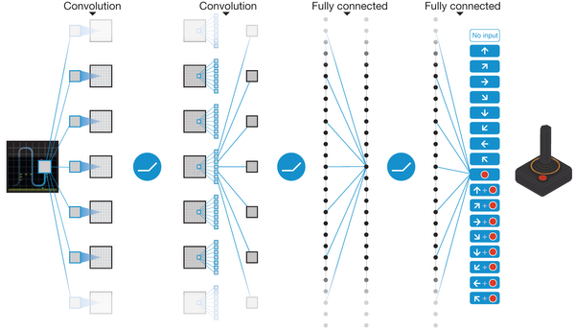
Related Works (contd)
Deep Q-learning: model-free approach to reinforcement learning using deep networks in environments with discrete action choices (Mnih et al., 2015).
Source: (Mnih et al., 2015)
Figure 13: Deep Q Learning

Slide 33
Figure 14: Deep learning on the TIMIT database
Source: (Mohammed, Dahl, & Hinton, 2012)

Slide 34
GPU vs CPU
(Raina et al., 2014) suggested that GPU’s could operate at speeds up to 70 times faster than the CPU counterparts and increasingly realized that making use of lots of training data and of fast computation had been greatly undervalued in favor of incremental changes in learning algorithms.

Slide 35
Application areas

Slide 36
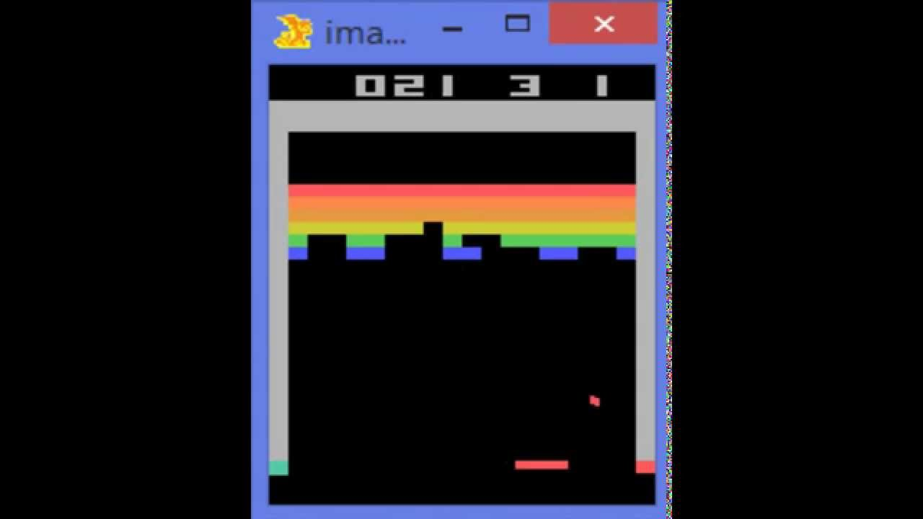
Game Playing
By just receiving pixels on the screen to minimize the score, this program can outperform humans in over 30 Atari games.
Figure 15: Computer Learning Atari
Source: https://www.youtube.com/watch?v=V1eYniJ0Rnk

Slide 37
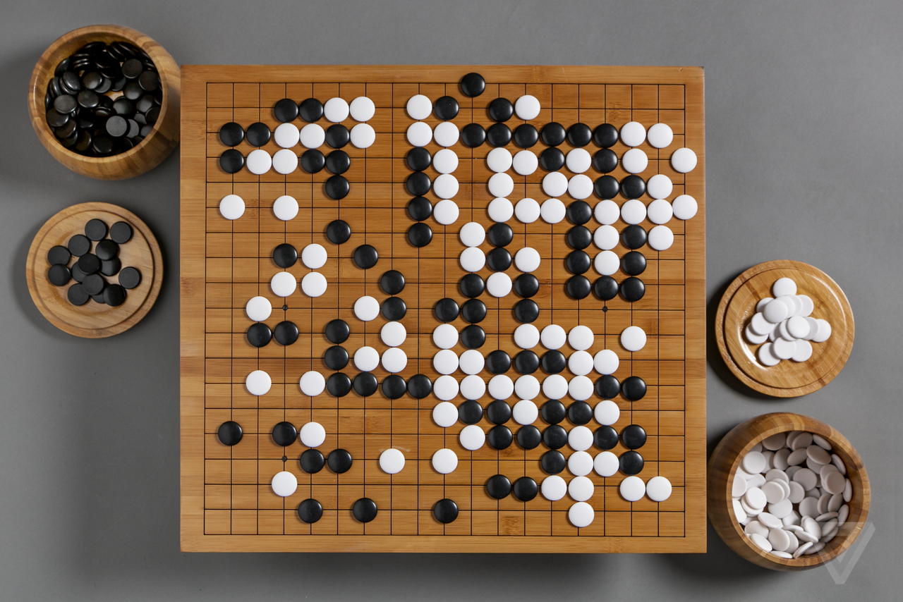
Application areas – Game Playing
In 2016, the world champion of the legendary Chinese game of Go was defeated by a Deep Learning-based program developed by Google DeepMind.
The possible moves from a given point on the board are more than the atoms in the universe!
Fig 16: Game of Go and the problem spaces.
Source: http://www.theverge.com/2016/3/8/11178462/google-deepmind-go-challenge-ai-vs-lee-sedol

Slide 38
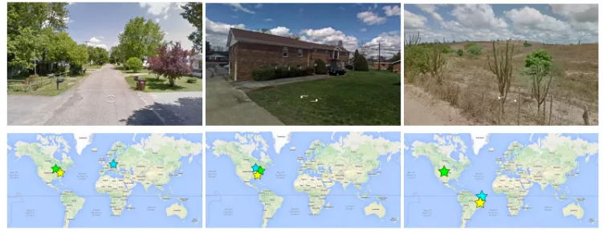
Application areas - Computer Vision
(Weyand et al., 2016) introduced PlaNet which takes a Photo and gives the exact location on the earth.
Figure 17: Images from PlaNet with exact locations of places on earth.
Source: Weyand et al. (2016)

Slide 39
Application areas (contd)
Automotive – Self-driving cars
Natural language Processing
Optical Character Recognition
Robotics
CRM
Bioinformatics

Slide 40
One more thing…

Slide 41

Source: https://www.youtube.com/watch?v=Dy0hJWltsyE&t=3s

Slide 42
Conclusion
Despite the faster change we have in technological advancements, we are still moving slow. We are barely scratching the surface of what’s possible in Artificial Intelligence and machine learning.

Slide 43
References
Abadi, M., Agarwal, A., Barham, P., Brevdo, E., Chen, Z., Citro, C., ... & Ghemawat, S. (2016). Tensorflow: Large-scale machine learning on heterogeneous distributed systems. arXiv preprint arXiv:1603.04467.
Alpaydin, E. (2014). Introduction to machine learning. MIT press.
Bengio, Y. (2009). Learning deep architectures for AI. Foundations and trends® in Machine Learning, 2(1), 1-127. Chicago
Bostrom, Nick (1998). How long before superintelligence? International Journal of Futures Studies 2.
Dahl, G. E., Yu, D., Deng, L., & Acero, A. (2012). Context-dependent pre-trained deep neural networks for large-vocabulary speech recognition. IEEE Transactions on Audio, Speech, and Language Processing, 20(1), 30-42.
Frank, I. , & James, K. (2013). Recognition of Nigerian Major Languages Using Neural Networks. Journal of Computer Networks, 1(2), 32-37.
Graves, A., Mohamed, A. R., & Hinton, G. (2013, May). Speech recognition with deep recurrent neural networks. In 2013 IEEE international conference on acoustics, speech and signal processing (pp. 6645-6649). IEEE.
Gubrud, M. A. (1997, November). Nanotechnology and international security. In Fifth Foresight Conference on Molecular Nanotechnology (Vol. 1).

Slide 44
References cont’
Hannun, A., Case, C., Casper, J., Catanzaro, B., Diamos, G., Elsen, E., ... & Ng, A. Y. (2014). Deep speech: Scaling up end-to-end speech recognition. arXiv preprint arXiv:1412.5567.
Hinton, G., Deng, L., Yu, D., Dahl, G. E., Mohamed, A. R., Jaitly, N., ... & Kingsbury, B. (2012). Deep neural networks for acoustic modeling in speech recognition: The shared views of four research groups. IEEE Signal Processing Magazine, 29(6), 82-97.
Hinton, G. E., Osindero, S., & Teh, Y. W. (2006). A fast learning algorithm for deep belief nets. Neural computation, 18(7), 1527-1554
Jia, Y., Shelhamer, E., Donahue, J., Karayev, S., Long, J., Girshick, R., ... & Darrell, T. (2014, November). Caffe: Convolutional architecture for fast feature embedding. In Proceedings of the 22nd ACM international conference on Multimedia (pp. 675-678). ACM.
Mnih, V., Kavukcuoglu, K., Silver, D., Rusu, A. A., Veness, J., Bellemare, M. G., ... & Petersen, S. (2015). Human-level control through deep reinforcement learning. Nature, 518(7540), 529-533.
Mohamed, A. R., Dahl, G. E., & Hinton, G. (2012). Acoustic modeling using deep belief networks. IEEE Transactions on Audio, Speech, and Language Processing, 20(1), 14-22.
Natarajan, B. K. (2014). Machine learning: a theoretical approach. Morgan Kaufmann.

Slide 45
References cont’
Team, T. T. D., Al-Rfou, R., Alain, G., Almahairi, A., Angermueller, C., Bahdanau, D., ... & Belopolsky, A. (2016). Theano: A Python framework for fast computation of mathematical expressions. arXiv preprint arXiv:1605.02688.
Raina, R., Madhavan, A., & Ng, A. Y. (2009, June). Large-scale deep unsupervised learning using graphics processors. In Proceedings of the 26th annual international conference on machine learning (pp. 873-880). ACM.
Vedaldi, A., & Lenc, K. (2015, October). Matconvnet: Convolutional neural networks for matlab. In Proceedings of the 23rd ACM international conference on Multimedia (pp. 689-692). ACM.
Weyand, T., Kostrikov, I., & Philbin, J. (2016). Planet-photo geolocation with convolutional neural networks. arXiv preprint arXiv:1602.05314.

Slide 46
Acknowledgments
I wish to express my sincere gratitude to God who by Inspiration gave me this topic.
I sincerely thank Professor Sanjay Misra for the guidance and encouragement in carrying out the research work as well as Mr Wole Adewunmi for the helps.
I wish to express my gratitude to Dr. (Mrs) Oladipupo and the PG co-ordinator Dr Oyelade for the continuous insights in getting this presentation ready as well as the management of Covenant University for this platform to share ideas and push humanity forward.
And to my family, friends and everyone present here today.

Slide 47


